Slide 1
Storage Devices

Slide 2
Presentation Overview Storage ‌•Basic Units Of Data Storage ‌•Data Access Methods Magnetic Disks •Hard Disk ‌•Floppy Disk or Diskette ‌•Zip Disk ‌•Super Disk Optical Disk ‌•CD ‌•DVD ‌•Blu-Ray Disk Flash Memory Storage ‌•Solid State Drives ‌•USB Flash Drives ‌•Memory Cards

Slide 3
Storage
Computer data storage, often called storage or memory, is a technology consisting of computer components and recording media used to retain digital data. It is a core function and fundamental component of computers
Storage is required for following reason:
The main memory is temporary memory. the storage is required to store data and programs permanently.
The capacity is limited. The storage is required to store a large amount of data and program

Slide 4
Basic unit of data storage 1. Bit Computer works with binary digits. These digits are in the form of 0’s and 1’s. A binary digit is called bit. One bit takes one storage location in memory. It is the smallest unit for data storage. 2. Byte A collection of eight bits is called byte. It is used to store single character. The capacity of the memory or the storage is expressed in terms of bytes. 3. Kilobyte A kilobyte consists of 1024 bytes. It is denoted by KB. 4. Megabyte A megabyte consists of 1024 kilobytes. It is denoted by MB. 5. Gigabyte A gigabyte consists of 1024 megabytes. It is denoted by GB. 6. Terabyte A terabyte consists of 1024 gigabytes. It is denoted by TB.

Slide 5
Data Access Methods Different methods of accessing data are following: 1-Random access memory 2-Sequential access memory 1-Random access memory: Direct (out of sequence or random) access by a computer (CPU) means that data can be retrieved directly from any location on a storage medium in any order. More precisely called Direct Access. A random-access data file enables you to read or write information anywhere in the file. All storage devices used today are random access devices: >CD/DVD Drives >USB Flash Drives

Slide 6
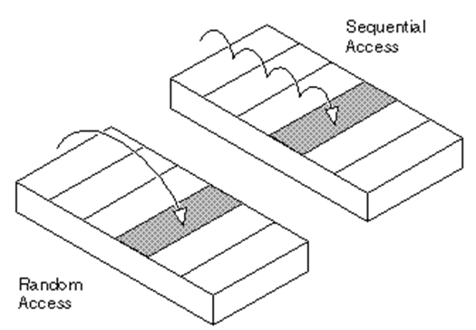
2-Sequential access memory (SAM) Sequential access memory (SAM) is a class of data storage devices that read stored data in a sequence. Magnetic sequential access memory is typically used for secondary storage in general-purpose computers due to their higher density at lower cost compared to RAM, as well as resistance to wear and non-volatility. Examples of SAM devices still in use include: > Hard Disks > CD-ROMs > Magnetic tapes.

Slide 7
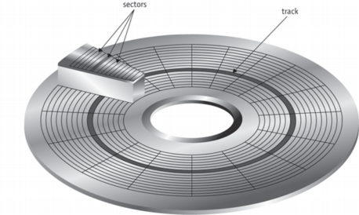
Magnetic Disks A magnetic disk is a storage device that uses a magnetization process to write, rewrite and access data. It is covered with a magnetic coating and stores data in the form of tracks, spots and sectors. Tracks form circles on the surface of a magnetic disk. Each track on a disc is divided into two sectors. Each sector typically stores up to 512 bytes of data. Hard disks, zip disks and floppy disks are common examples of magnetic disks.

Slide 8
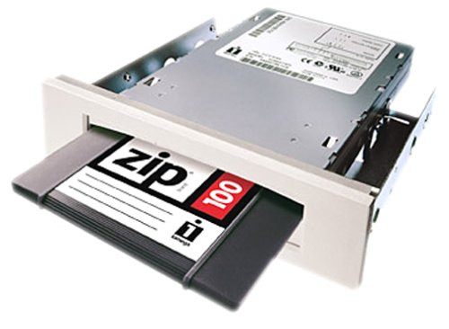
Zip Disk The Zip drive is a medium-to-high-capacity removable floppy disk storage system (for its period of contemporary use) that was introduced by Iomega in late 1994. Originally Zip disks launched with capacities of 100 MB, but later versions increased this to first 250 MB and then 750 MB. Super Disk A disk storage technology developed by Imation Corporation that supports very high-density diskettes. Its capacity is 120MB to 250 MB. It can also read the standard 1.44 MB floppy disk.

Slide 9
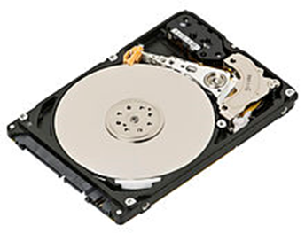
HARD DISK A hard disk is part of a unit, often called a "disk drive," "hard drive," or "hard disk drive," that stores and provides relatively quick access to large amounts of data on an electromagnetically charged surface or set of surfaces. Today's computers typically come with a hard disk that contains several billion bytes (gigabytes) of storage. A hard disk is really a set of stacked "disks," each of which, like phonograph records, has data recorded electromagnetically in concentric circles or "tracks" on the disk. A "head” records or reads the information on the tracks. Two heads, one on each side of a disk, read or write the data as the disk spins. Each read or write operation requires that data be located, which is an operation called a "seek."

Slide 10
HARD DISK PERFORMNCE The following factors affect the performance of hard disc ✔SEEK TIME It is also called positioning performance. It is time required by read/write head to reach the correct location on the disk. It is measured in milliseconds. ✔SPINDLE SPEED It is also called transfer performance. It is the speed at which the drive transfers data. It is measured in revolutions per minute (RPM). ✔LATENCY It is the time required by the spinning platter to bring the desired data to read/write head. It is measured in milliseconds. A removable hard disc is a type of hard disc that can be inserted and removed from a drive. The removable hard disk drive is used to read and write data on the removable hard disk. The storage capacity of removable hard disk is up to 1TB and more.

Slide 11
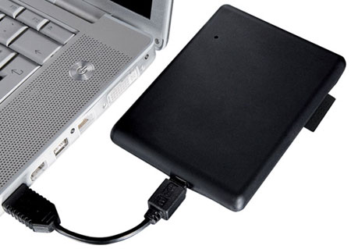
EXTERNAL AND REMOVABLE HARD DISK An external hard disk is a separate hard disk that is connected to USB port or FireWire port on system unit. The advantage of external hard disk is that it can be installed without opening the system unit. The storage capacity of external hard disk is up to 4TB and more. ADVANTAGES SOME important advantages are as following. ✔These can be used to transfer large number of files from one place to another. ✔These disk can store large number of audio and video files easily. ✔These disk can be used to backup important files or entire internal hard disk.

Slide 12
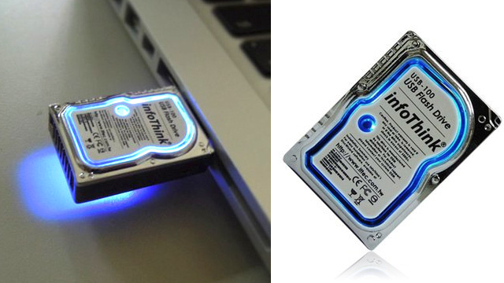
MINIATURE HARD DISKS The miniature hard disc are very small hard disks. These disks are available in different sizes such as 0.85 inch or 1 inch or 1.8 inch. Both internal and external hard disks are available in miniature sizes. These devices such as portable media player, digital camera, smartphones usually have internal miniature hard disks. The storage capacity of miniature hard disk is from 1GB to 320GB.

Slide 13
DISK CACHE Disk caching is often used to speed up magnetic hard drive performance. Today’s hard drives typically use a disk cache consisting of memory chips that is located on circuit board inside the hard drive case. The computer copies the requested data to the disk cache any time the hard drive is accessed.

Slide 14
FLOPPY DISKS » Floppy disks are also known as Diskette. » Floppy disk is a portable magnetic storage device. » A floppy disk can store up to 1.44 Mb of data which is equivalent to around 300 pages of A4 text. » They used to be the ideal storage device for transferring small files from home to work/school or from one office computer to another. But nowadays, many files contain graphics that are larger than the size of the floppy disk so it is not commonly used now a days. » All disks must be formatted before data can be written to the disk. Formatting divides the disk up into sections or sectors onto which data files are stored. Advantages ✔Portable - small and lightweight ,inexpensive ✔Useful for transferring small files between home and school ✔Can be used many times

Slide 15
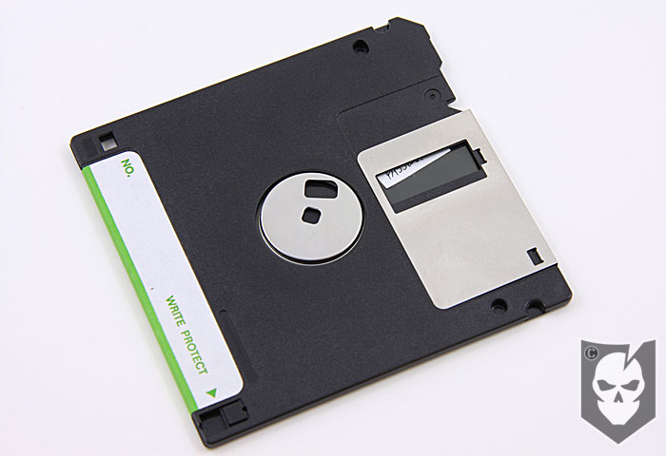
Disadvantages ✔Not very strong - easy to damage ✔Data can be erased if the disk comes into contact with a magnetic field ✔Quite slow to access and retrieve data when compared to a hard disk ✔Can transport viruses from one machine to another ✔Small storage capacity

Slide 16
Flash memory Storage Flash memory is a solid-state chip that maintains stored data without any external power source. It is commonly used in portable electronics and removable storage devices, and to replace computer hard drive Flash memory is widely use in smart phone, digital camera , portable media player Types of flash memory: ❒ Solid state drives The newest flash memory application, SSDs can replace a computer's hard drive. They have no moving parts, so mechanical failure is near zero. Solid-state drives are quieter and smaller than hard drives, and they provide faster response, access and boot-up times but consume much less power and run cooler.

Slide 17
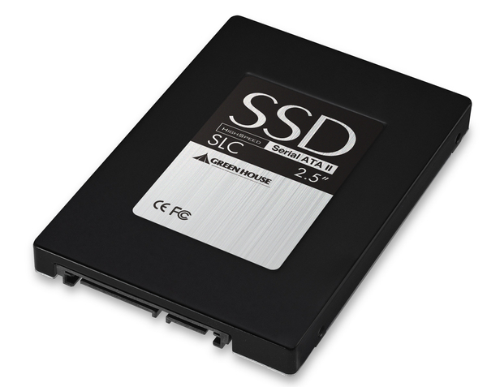
Advantages: ✔Provide faster data access and data transfer. ✔They do not generate noise. ✔Security – allowing a very quick scan of all data stored. ✔Some of the storage devices are waterproof. Disadvantages: ✔Price – solid state drives are more expensive than magnetic hard drive. ✔Recovery of data in case of failure can be more difficult than magnetic hard drive

Slide 18
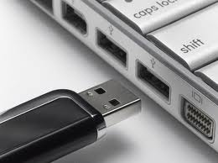
❒USB Flash Drive USB flash drive is a flash memory storage drive also are called thumb drives, jump drives, pen drives, key drives, tokens, or simply USB drives. A small, portable flash memory card that plugs into a computer USB port and functions as a portable hard drive. USB flash drives are touted as being easy-to-use as they are small enough to be carried in a pocket and can plug into any computer with a USB drive. USB flash drives have less storage capacity than an external hard drive, but they are smaller and more durable because they do not contain any internal moving parts.

Slide 19
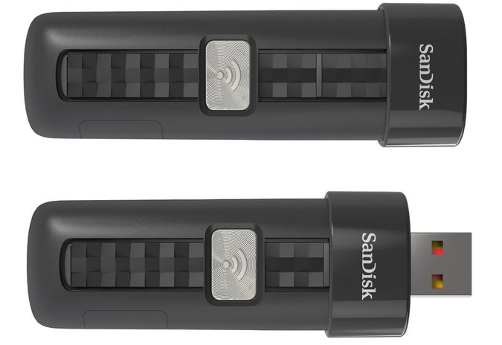
Wireless flash drive Wireless flash drive is used to store and share data wirelessly across mobile devices and computers. It is portable and very easy to use It connects wirelessly up to eight drives and stream video at the same time via Wi-Fi. Wireless flash drives are available in 16GB, 32GB and 64GB Example: SanDisk Connect.

Slide 20
Memory cards A memory card or flash card is an electronic flash memory data storage used for storing digital information. These are commonly used in portable electronic devices, such as digital cameras, mobile phones, laptop computers, tablets, MP3 players and video game consoles. A memory card can be inserted into a slot on computer or mobile device. However a card reader can be attached to a computer if it does not have a slot. Types: ❒ Compact Flash (CF) Invented by SanDisk Corporation in 1994, CompactFlash cards can support 3.3V and 5V operation and can switch between the two, in contrast to other small-form factor flash memory cards that can operate only at one voltage. The storage capacity of compact flash can be from 8GB to 512GB.

Slide 21
❒ Secure Digital Card (SD card) SD cards are used in many small portable devices such as digital video camcorders, digital cameras, handheld computers, audio players and mobile phones.SD Memory Cards are now available in capacities between 16 Megabytes and 1 Gigabyte, and still growing. It provide a storage capacity up to 32GB. ❒ Memory stick media Memory Stick is a removable flash memory card format, launched by Sony and is also used in general to describe the whole family of Memory Sticks. In addition to the original Memory Stick, this family includes the Memory Stick PRO, a revision that allows greater maximum storage capacity and faster file transfer speeds. Another type of memory stick is called Memory Stick Micro (M2) with storage capacity of 2GB to 4GB.

Slide 22
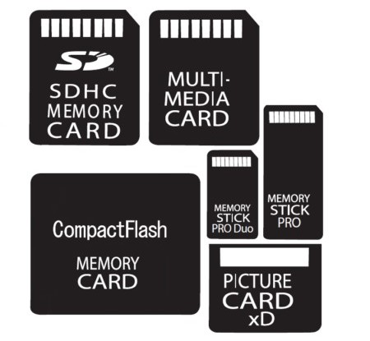
❒ Security digital Memory Cards SDXC Security digital extended capacity is commonly used in digital cameras. It provides the storage capacity of 32GB upto2TB

Slide 23
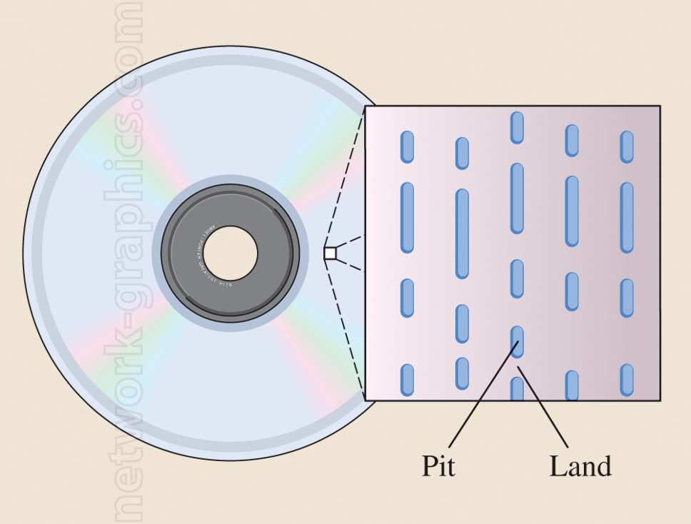
OPTICAL DISC Optical disc is a form of removable storage. It includes CDs , DVDs and blue ray discs, Optical drives use a laser to read and write data on optical disc. The laser stands for Light Amplification through Stimulated Emission of Radiation. Laser beam writes on the surface by creating small pit (hole) in the disc. Optical disc commonly store data in single track. Optical disc storage capacity is from 700 MB to several GB.The main catagories of optical disc are CD and DVD.

Slide 24
CD CD stands for Compact Disc. It is mainly used to store photos, audio and computer software. CDs are available in three types which are read only recordable and rewriteable. Different types of CDs are as follows. 1-CD-ROM CD-ROM stands for Compact DISC Read-Only Memory. The data stored on CD-ROM can only be read. It cannot be deleted or changed. It can store up to 700MB of data. USES OF CD-ROM CR-ROM is mostly used to store photos and audios. It is often used to distribute new application software and games. ADVANTGES OF CD-ROM ✔It is the least expensive way to store data and information. ✔CD-ROM discs are durable and easy to handle. DISTAVANTAGES OF CD-ROM ✔The data cannot be edited. ✔It retrieves data and information more slowly than magnetic hard disk.

Slide 25
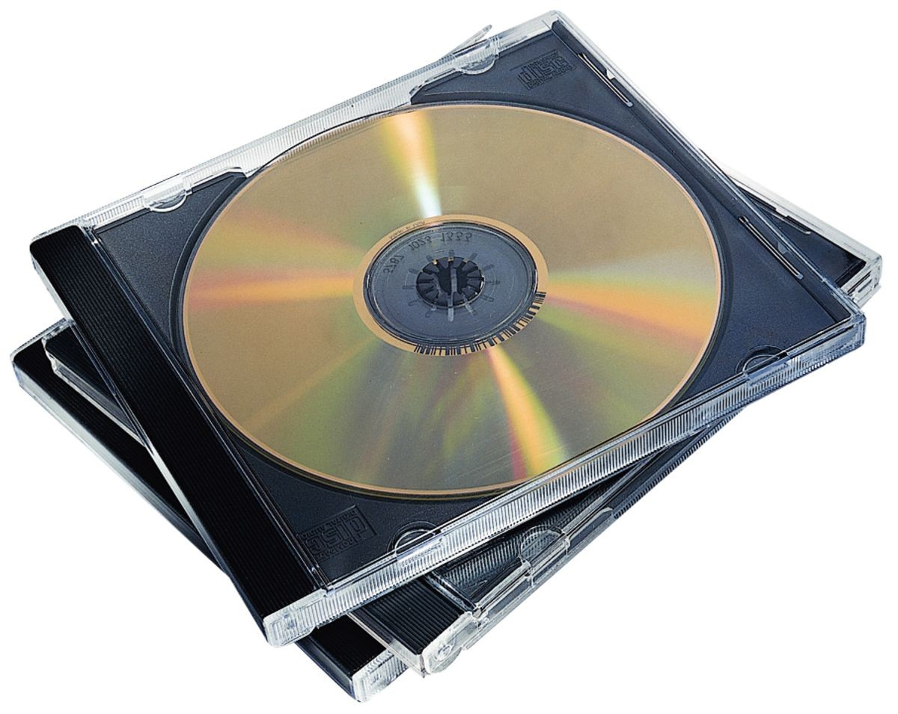
2-CD-R CD-R stands for CD Recordable. The user can write data on CD-R only once but can read it many times. The data written on CD-R cannot be erased. CD-R drives are known as CD burners. The process of recording data on CD-R is called burning. CD-R is known as WORM (Write Once Read Many). 3-CD-RW CD-RW stands for Compact Disc Rewriteable. It is also known as erasable optical disc. The most common type erasable and rewritable optical disc is magneto-optical disc.

Slide 26
DVD DVD stands for Digital Video Disc. The storage capacity of DVD is much greater than CD. It can store up to 17 GB of data. DVDs are available in three types which are read-only , recordable and rewritable. TYPES: 1-DVD-ROM DVD-ROM stands for Digital Video Disc Read Only Memory. It is high capacity optical disc that the users can only read but not write or erase. 2-DVD-R DVD-R stands for Digital Video Disc Recordable. It is similar to CD-R disc. The written data cannot be erased.

Slide 27
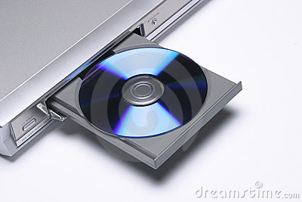
3-DVD-RW DVD-RW stands for Digital Video Disc Rewritable. The user can write data on CD-RW many times by erasing the existing contents. BLU-RAY DISC Blu-Ray disc is a new and more expensive DVD format. It provides higher capacity and better quality than standards DVDs especially for high-definition video. It can store up to 100 GB of data.

